Slide 1
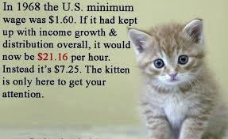
Income Inequality

Slide 2
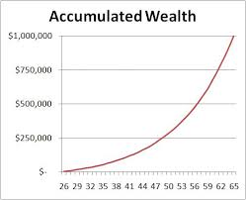
Measuring
Income
Wealth
Wages for Work
Accumulated Assets

Slide 3
Healthy Competition or “Bad for Business”?

Slide 4
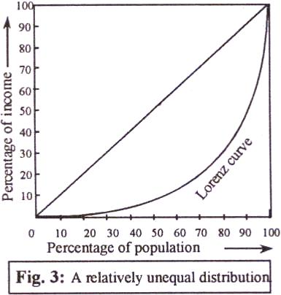
The Lorenz Curve

Slide 5
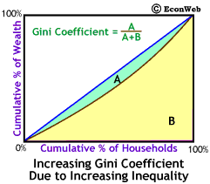
The Gini Coefficient

Slide 6
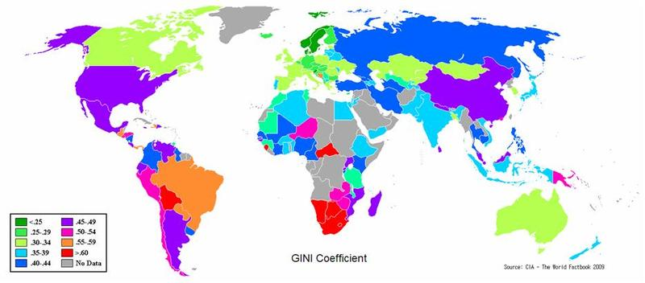

Slide 7
